Slide 1
ViTALiTy: Unifying Low-rank and Sparse Approximation for Vision Transformer Acceleration with a Linear Taylor Attention
Jyotikrishna Dass*†, Shang Wu*†, Huihong Shi*‡,
Chaojian Li‡, Zhifan Ye†‡, Zhongfeng Wang§, and Yingyan (Celine) Lin‡
†Rice University, §Nanjing University‡, Georgia Institute of Technology
^{*: equal contribution}
Notes:
Good Afternoon! Today, we are going to present “title”

Slide 2
Background: Vision Transformers (ViTs)
SOTA performance in various computer vision tasks
Key enabler in ViTs: Multi-head attention (MHA) captures global information and long-range interactions
Notes:
As it is well known, Vision Transformers have achieved SOTA performance in many Computer Vision tasks by outperforming CNNs in accuracy. The success of ViTs is attributed to its Multi-head attention component or MHA that can capture global information and long-range interactions across patches of an image.

Slide 3
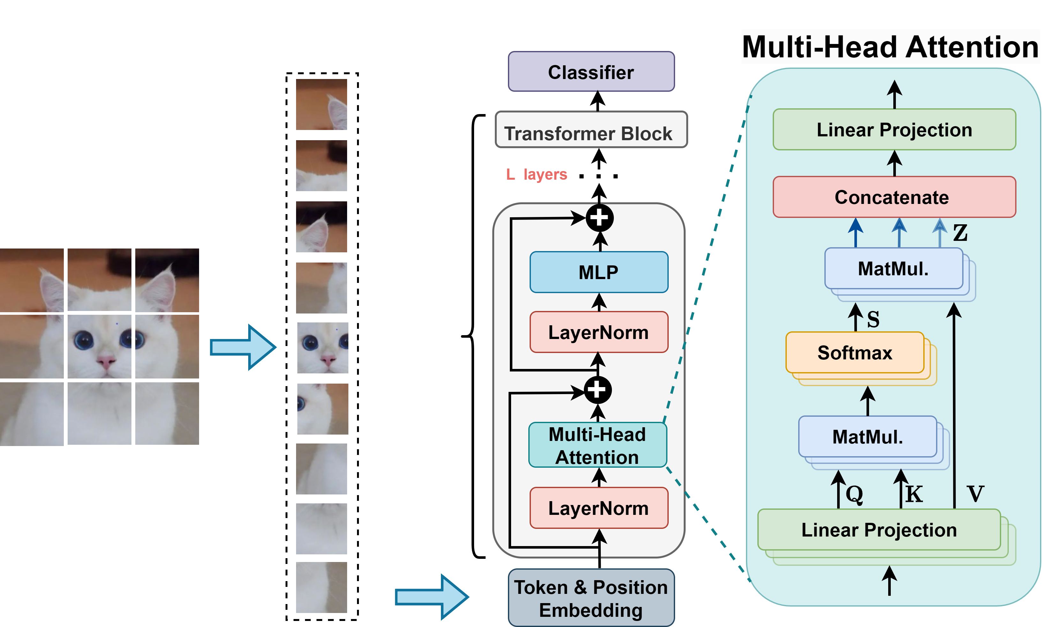
Background: Vision Transformers (ViTs)
SOTA performance in various computer vision tasks
Key enabler in ViTs: Multi-head attention (MHA) captures global information and long-range interactions
Step 3: Z$=S V$
Step 2: $S=softmax\left(\frac{QK^{T}}{\sqrt{d}}\right)$
Step 1:
$Q=XW^{Q},K=XW^{K}$, $V=XW^{V}$
Block Diagram of a Vision Transformer Model
Notes:
In a typical ViT model, input images are split into patches and fed into the model comprising multiple layers of Transformer blocks.
Each transformer block has an MHA module where the input X goes through a 3-step computation: computing Q/K/V vectors, followed by calculating the softmax attention S, and finally computing the attention score Z

Slide 4
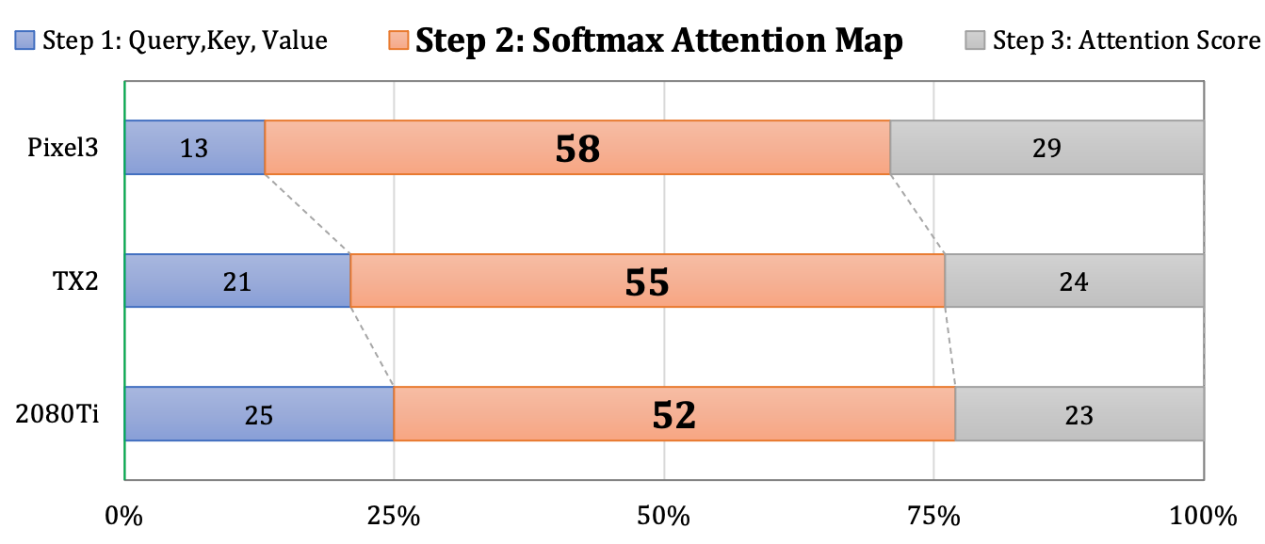
Motivation: MHA Runtime Profile on Edge
Less Power
Resource-constrained
Edge Devices
More power Resource-rich
Percentage Breakdown
(ViT model: DeiT-Tiny)
Notes:
Despite its impressive performance, ViTs are not friendly to hardware efficiency
due to their required MHA modules. To better understand the underlying cause, we profile Multi-head attention runtime, comprising the three steps, in terms of percentage breakdown across various commercial edge devices: ranging from powerful and resource rich to less powerful resource-constrained devices.

Slide 5
Motivation: MHA Runtime Profile on Edge
Less Power
Resource-constrained
Edge Devices
More power Resource-rich
Percentage Breakdown
(ViT model: DeiT-Tiny)
Motivating Observation: Softmax attention (Step 2) is the runtime bottleneck (52% $\sim$ 58%)
Notes:
As shown in this figure, we observe that Softmax attention (the Step 2) is the most dominant slice, and it results in a runtime bottleneck and contributes 52% to 58% of the latency as device becomes more resource-constrained

Slide 6
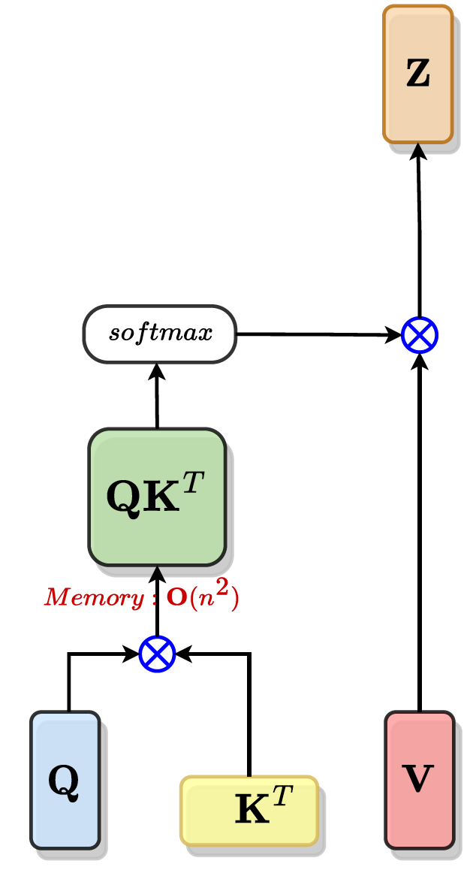
Motivation: Why Softmax Attention is Bottleneck ?
$Z=softmax\left(\frac{QK^{T}}{\sqrt{d}}\right)× V$ = S V
Workflow of
Softmax Attention
$$d$$
$$n$$
$$d$$
$$n$$
$$n$$
$$⨂$$
$$d$$
S
Attention Complexity:
$QK^{T}$ Time $Ο\left(n^{2}d\right)$ , Memory$Ο\left(n^{2}\right)$
$$n$$
$$n$$
$n$: number of tokens (e.g., 196$\sim$16K )
$d$: hidden dimension per head (e.g., 64)
$$d$$
$$d$$
$$n$$
Quadratic Complexity
➔ Limits efficiency and scalability
$$n$$
$$n$$
$$d$$
Notes:
To answer why softmax attention is the bottleneck, we calculate the asymptotic complexity of various computational steps in MHA in terms of the number of patches “n” and the dimension per head “d”.
It can be seen that computing and storing QK^T has quadratic complexity in “n” which is typically much higher than “d”, thereby resulting in challenges such as
Limiting ViT efficiency and scalability
Prohibiting ViT’s deployment on resource-constrained devices.

Slide 7
Related Work - Algorithms
New ViT Models
ViT Compression Techniques
Multi-stage hierarchical ViT
Pyramid ViT [ICCV, 2021]
Swin Transformer [ICCV, 2021]
Focal Transformer [NeurIPS, 2021]
CrossViT [ICCV, 2021]
Hybrid CNN+ViT
MobileViT [ICLR, 2022]
LeViT [ICCV, 2021]
Automated ViT
NASViT [ICLR, 2022]
Pruning [KDD, 2021]
Quantization [NeurIPS, 2021]
Common in all: Softmax used for Attention
Notes:
Various algorithm-level works have been designed for ViT from new ViT models to ViT compression techniques to reduce the time and space complexity.
NEW VIT MODELS
Multi-Stage Hierarchical ViT focus on gradually reducing #tokens Hybrid architectures combine the strengths of CNNs and ViTs for accuracy and efficiency tradeoff
Neural architecture search (NAS) to automatically discover efficient ViT models
COMPRESSION
Such as Pruning encouraging dimension-wise sparsity; and (Post-training mixed-precision) quantization for reducing memory storage and computational costs;
(click)
However, these works commonly use softmax for attention within limited fixed-size local windows or reduced dimensions
- hurts ViT’s non-local attention capability compared to full attention. - Softmax not suitable for high-resolution vision tasks

Slide 8
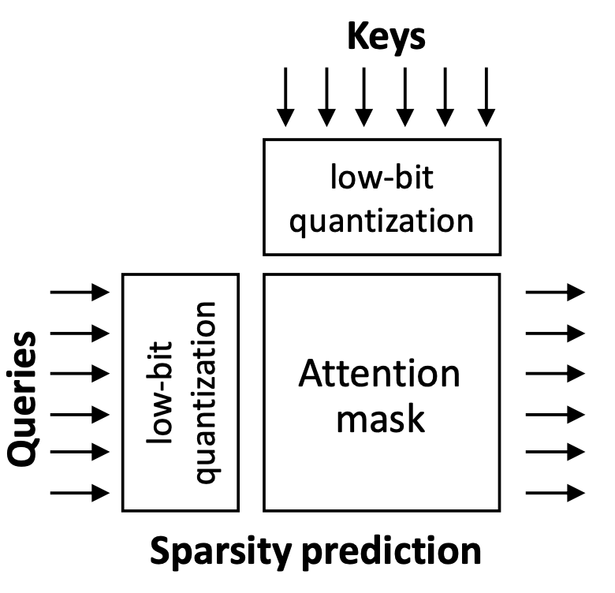
Related Work - Accelerators
New ViT Models
ViT Compression Techniques
Multi-stage hierarchical ViT
Pyramid ViT [ICCV, 2021]
Swin Transformer [ICCV, 2021]
Focal Transformer [NeurIPS, 2021]
CrossViT [ICCV, 2021]
Hybrid CNN+ViT
MobileViT [ICLR, 2022]
LeViT [ICCV, 2021]
Automated ViT
NASViT [ICLR, 2022]
Pruning [KDD, 2021]
Quantization [NeurIPS, 2021]
Co-designed (NLP)
Transformer Accelerators
A³ [HPCA, 2020]
SpAtten [HPCA, 2021]
Sanger [MICRO, 2021]
ELSA [ISCA, 2021]
DOTA [ASPLOS, 2022]
Software pruning for
sparse attention
Limitation
Dynamic sparsity at runtime ➔ Nontrivial overhead
Notes:
In the HW community, emphasis has been given to Language-based transformer accelerators
where the goal is to introduce sparsity in approximating the softmax attention.
(click)
However, these works rely on dynamic sparsity at runtime
- that generally leads to nontrivial overhead in Hardware design for inference.
Moreover, there is a missing gap in literature for co-designing efficient ViT-based accelerators where the image data is of fixed size and tends to show spatial and local correlation compared to language data.

Slide 9
Motivating Research Question
Can we more effectively approximate Softmax Attention with Linearized Attention?
Notes:
We motivate our work by posing the following questions

Slide 10
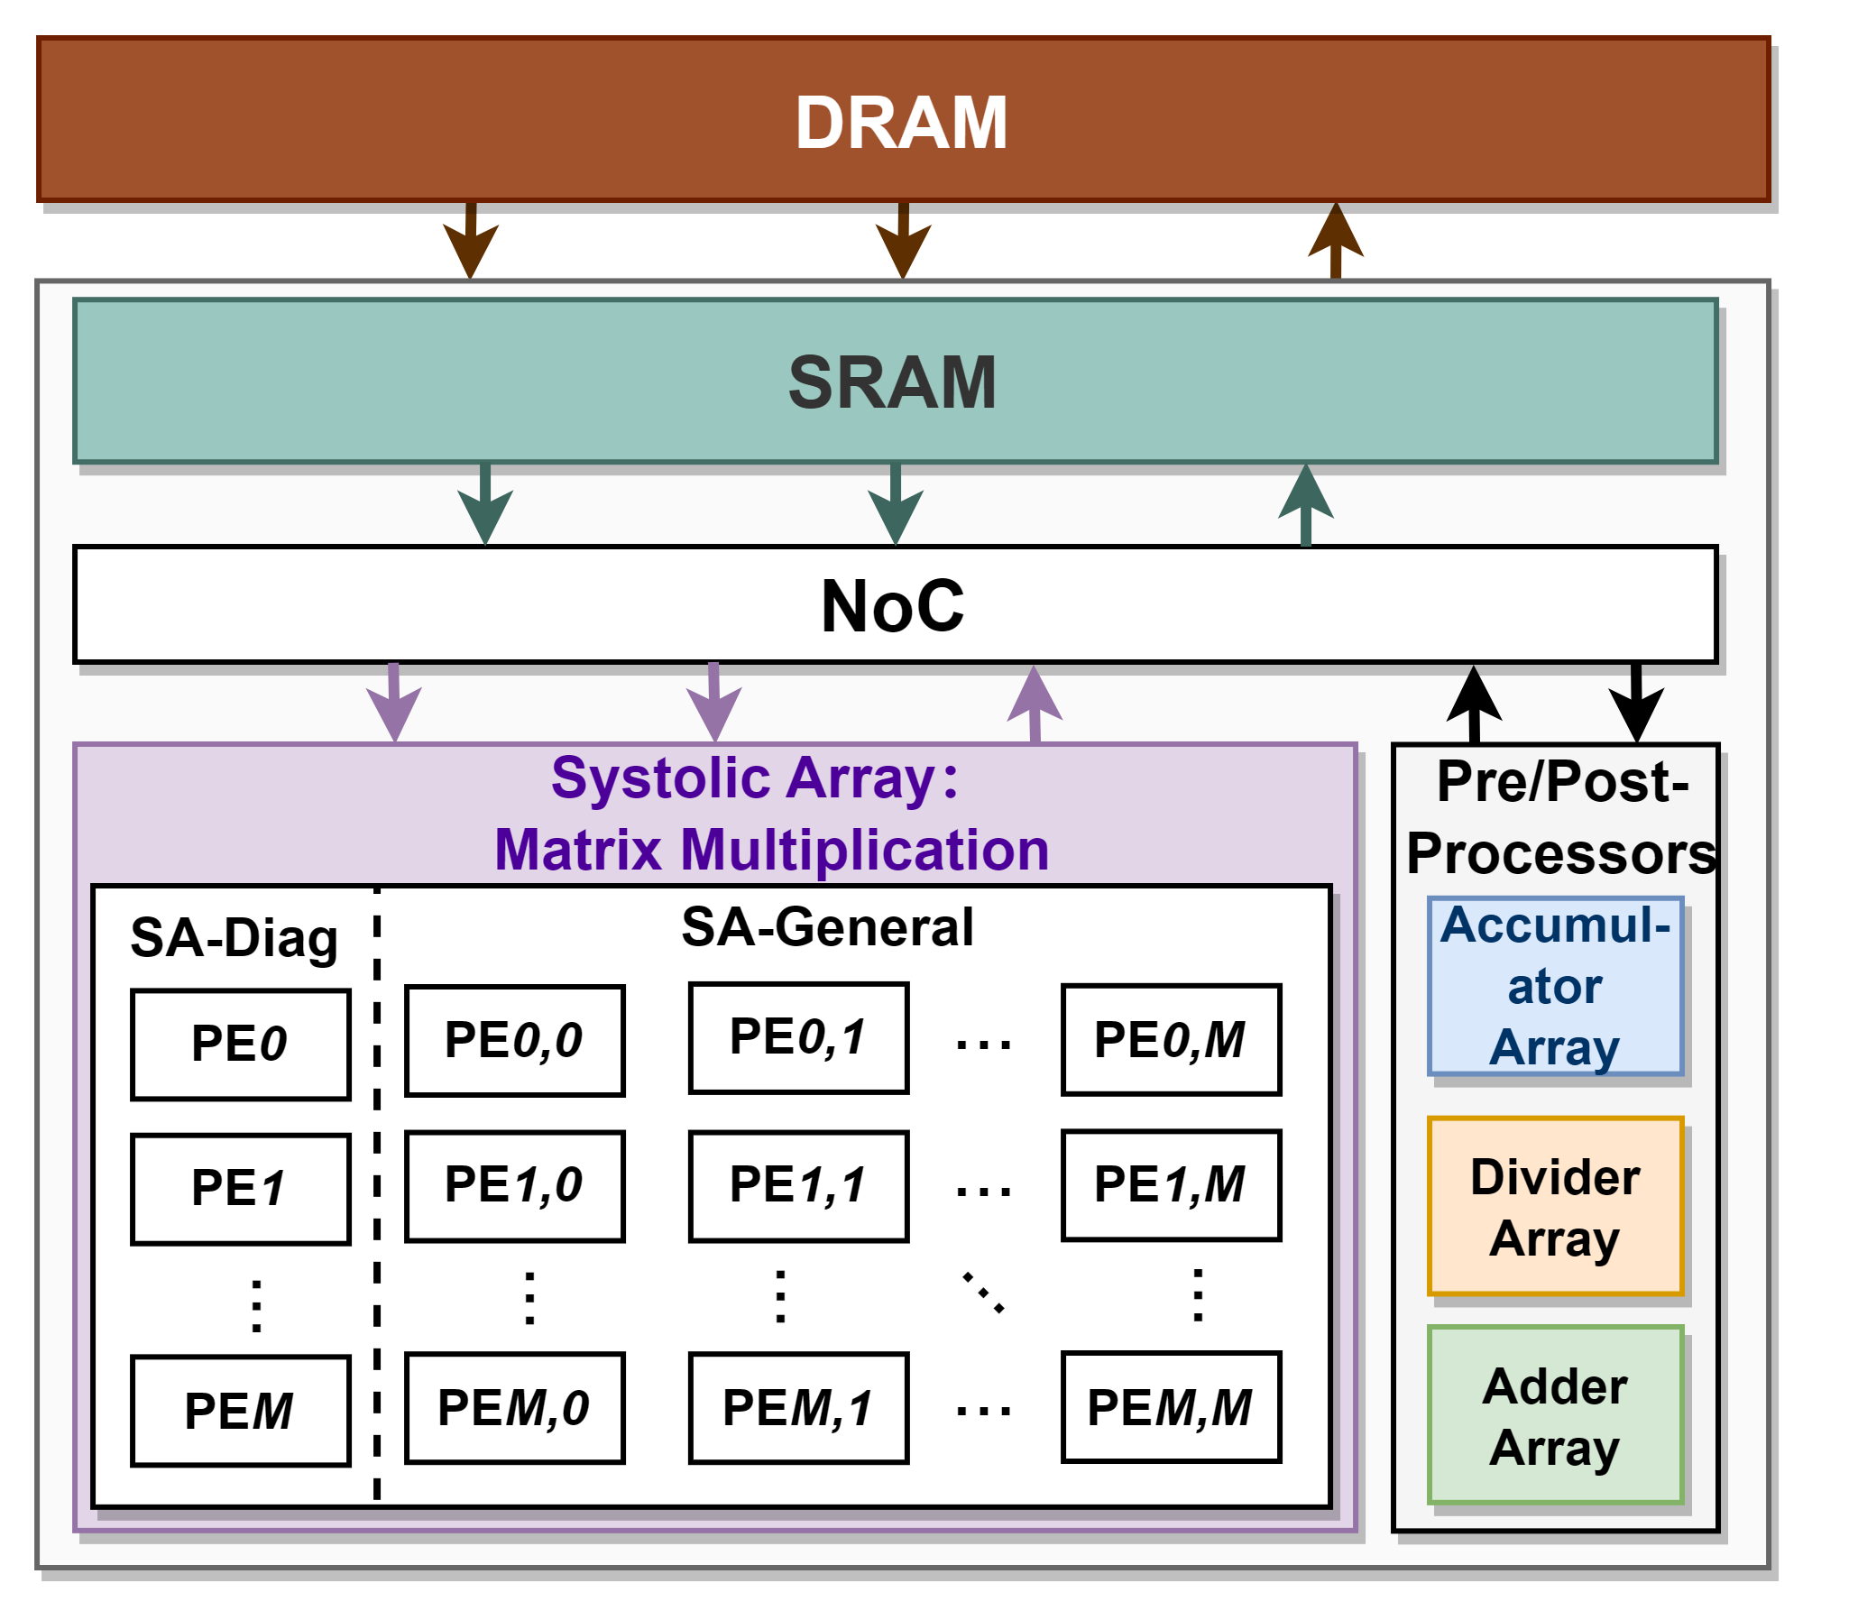
Overview of Our Proposed Framework
ViTALiTy: Unifying Low-rank and Sparse Approximation for ViT Acceleration using Linear Taylor Attention
ViTALiTy Algorithm
ViTALiTy Accelerator
Linear Attention
Based on Taylor expansion
and
Algorithm & Accelerator
Co-Design
A training pipeline
Unifies Low-rank
& Sparse Approximation
Merely Low-rank
component for inference
The 1st co-designed ViT work leveraging low-rank linear attention
Higher accuracy (+2.4% to +3.6%) than existing linear attention
3$×$ efficiency than SOTA accelerator
Notes:
In response to these questions, we propose VITALITY.
At Algorithm level, we propose a linear attention algorithm and a training pipeline that unifies low-rank and sparse approximation
At Accelerator level, we exploit the low-rank component without introducing any run-time sparsity
Major highlights of our work are
First codesigned accelerator for
Higher accuracy….
ViTALITY achieves... [TARGET END OF 5-min HERE]

Slide 11
Proposed
ViTALiTy Algorithm
Notes:
Here we first go over the proposed ViTALiTy algorithm.

Slide 12
Proposed Taylor Attention: Motivation
Is softmax the only method for computing ViT attention? No! It is just one type of similarity measure
Quadratic
Linear
$softmax\left(QK^{T}\right)V$ $≈\left\{φ\left(Q\right)φ\left(K\right)T\right\} V$ $=φ(Q)\left\{φ\left(K\right)TV\right\}$
$$Ο\left(n^{2}d\right)$$
Similarity measure
$$Ο\left(nd^{2}\right)$$
Efficient Attention [WACV, 2021]: $φ=softmax\left( \right)$
Linear Transformer [ICML, 2020]: $φ=elu( )+1$
Notes:
First, the softmax is simply a special case of similarity measure between Q matrix and K matrix. By using matrix associative property, where K matrix and V matrix are multiplied first, leads to an attention with linear space and time complexity.

Slide 13
Proposed Taylor Attention: Motivation
$$Softmax\left(\frac{Q{\hat{K}}^{T}}{\sqrt{d}}\right)={\left.{Taylor}_{softmax}\left(\frac{Q{\hat{K}}^{T}}{\sqrt{d}}\right)\right|}_{m=1}$$
$$+{\left.{Taylor}_{softmax}\left(\frac{Q{\hat{K}}^{T}}{\sqrt{d}}\right)\right|}_{m>1}$$
First-Order Approximation
Higher-Order Terms
Notes:
Based on the findings, we propose Taylor attention.
Here we first represent softmax attention as Taylor Expansion comprising
First-order approximation and Higher-order Terms

Slide 14
Proposed Taylor Attention: Motivation
$$Softmax\left(\frac{Q{\hat{K}}^{T}}{\sqrt{d}}\right)={\left.{Taylor}_{softmax}\left(\frac{Q{\hat{K}}^{T}}{\sqrt{d}}\right)\right|}_{m=1}$$
$$+{\left.{Taylor}_{softmax}\left(\frac{Q{\hat{K}}^{T}}{\sqrt{d}}\right)\right|}_{m>1}$$
First-Order Approximation
Higher-Order Terms
What is softmax attention actually capturing ?

Slide 15
Proposed Taylor Attention: Motivation
$$Softmax\left(\frac{Q{\hat{K}}^{T}}{\sqrt{d}}\right)={\left.{Taylor}_{softmax}\left(\frac{Q{\hat{K}}^{T}}{\sqrt{d}}\right)\right|}_{m=1}$$
$$+{\left.{Taylor}_{softmax}\left(\frac{Q{\hat{K}}^{T}}{\sqrt{d}}\right)\right|}_{m>1}$$
First-Order Approximation
Higher-Order Terms
(Weak Attention)
(Strong Attention)
What is softmax attention actually capturing ?
Combination of both weak and strong Q, K correlations
Notes:
Q: What is softmax actually capturing ?
We identify that it inherently captures both weak and strong correlations
between Q matrix and K matrix

Slide 16
Proposed Taylor Attention: Motivation
$$Softmax\left(\frac{Q{\hat{K}}^{T}}{\sqrt{d}}\right)={\left.{Taylor}_{softmax}\left(\frac{Q{\hat{K}}^{T}}{\sqrt{d}}\right)\right|}_{m=1}$$
$$+{\left.{Taylor}_{softmax}\left(\frac{Q{\hat{K}}^{T}}{\sqrt{d}}\right)\right|}_{m>1}$$
First-Order Approximation
Higher-Order Terms
(Weak Attention)
(Strong Attention)
What is softmax attention actually capturing ?
Combination of both weak and strong Q, K correlations
Distribution (%) of Q,K similarity
Model: DeiT-Tiny
67%
mean-centering K
exp(${qk}^{T}$) ≈ 1 + ${qk}^{T}$
dense
weak
correlations
Notes:
More specifically, we find that after “MEAN-CENTERING of KEYS”, up to 67% of the “SIMILARITY” scores lie in minus one to one. These are dense and weak correlations which are represented by this first-order approximation.
While the remaining 33% similarity lying outside [-1, 1), with high magnitude, corresponds to sparse and strong connections represented by higher-order terms.

Slide 17
Proposed Taylor Attention
$$Softmax\left(\frac{Q{\hat{K}}^{T}}{\sqrt{d}}\right)={\left.{Taylor}_{softmax}\left(\frac{Q{\hat{K}}^{T}}{\sqrt{d}}\right)\right|}_{m=1}$$
$$+{\left.{Taylor}_{softmax}\left(\frac{Q{\hat{K}}^{T}}{\sqrt{d}}\right)\right|}_{m>1}$$
First-Order Approximation
Higher-Order Terms
(Weak Attention)
(Strong Attention)
How can we avoid quadratic complexity in attention ?

Slide 18
Proposed Taylor Attention
$$Softmax\left(\frac{Q{\hat{K}}^{T}}{\sqrt{d}}\right)={\left.{Taylor}_{softmax}\left(\frac{Q{\hat{K}}^{T}}{\sqrt{d}}\right)\right|}_{m=1}$$
$$+{\left.{Taylor}_{softmax}\left(\frac{Q{\hat{K}}^{T}}{\sqrt{d}}\right)\right|}_{m>1}$$
First-Order Approximation
Higher-Order Terms
(Weak Attention)
(Strong Attention)
How can we avoid quadratic complexity in attention ?
Linear attention $↔$ Proposed low-rank linear Taylor attention
$$Z= Softmax\left(\frac{Q{\hat{K}}^{T}}{\sqrt{d}}\right)× V ≈{\left.{Taylor}_{softmax}\left(\frac{Q{\hat{K}}^{T}}{\sqrt{d}}\right)\right|}_{m=1}× V$$
Linear Taylor Attention
$={diag}^{−1}\left(n \sqrt{d} 1_{n}+Q{\hat{k}}_{sum}^{T}\right) × (\sqrt{d} 1_{n}1_{n}^{T}V+Q({\hat{K}}^{T}V))$

Slide 19
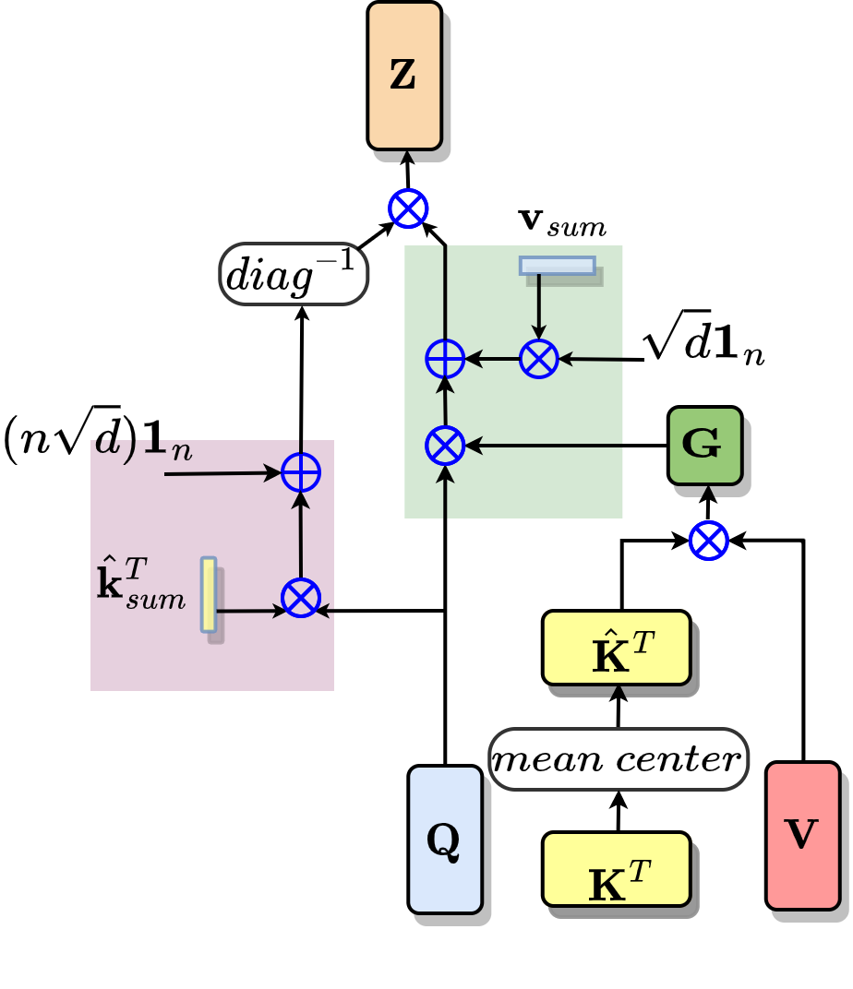
Proposed Taylor Attention: Benefit
Linear Taylor Attention
$Z={diag}^{−1}\left(n \sqrt{d} 1_{n}+Q{\hat{k}}_{sum}^{T}\right) × (\sqrt{d} 1_{n}1_{n}^{T}V+Q({\hat{K}}^{T}V))$
$$d$$
$$n$$
$$d$$
$$⨂$$
$$n$$
Time $Ο\left(nd^{2}\right)$
Memory$Ο\left(d^{2}\right)$
Reduces the attention FLOPs by
3$×$, 5$×$, 10$×$
on DeiT-Tiny, MobileViT-xs, LeViT-128
Notes:
Global context matrix G, compute time is linear in n while memory is independent of number of patches.
We observe that Linear Taylor Attention Reduces Attention Flops by 3x-10x on various ViT models

Slide 20
Proposed Taylor Attention: Issues
$$Softmax\left(\frac{Q{\hat{K}}^{T}}{\sqrt{d}}\right)={\left.{Taylor}_{softmax}\left(\frac{Q{\hat{K}}^{T}}{\sqrt{d}}\right)\right|}_{m=1}$$
$$+{\left.{Taylor}_{softmax}\left(\frac{Q{\hat{K}}^{T}}{\sqrt{d}}\right)\right|}_{m>1}$$
First-Order Approximation
Higher-Order Terms
(Weak Attention)
(Strong Attention)
Linear Taylor Attention (low-rank)
Issue 1: Direct first-order approximation causes severe accuracy drop
Baseline 76.6% $→$ 23.2% drop on average for 7 ViT models
Notes:
However, TAYLOR ATTENTION is a double-edged sword.
DESPITE THE BENEFITS OF LINEAR COMPLEXITY, it has couple of issues:
The first issue is that: directly applying the first-order approximation will cause a severe accuracy drop. On 7 ViT models, the accuracy drops from 76% to 23%.

Slide 21
Proposed Taylor Attention: Issues
$$Softmax\left(\frac{Q{\hat{K}}^{T}}{\sqrt{d}}\right)={\left.{Taylor}_{softmax}\left(\frac{Q{\hat{K}}^{T}}{\sqrt{d}}\right)\right|}_{m=1}$$
$$+{\left.{Taylor}_{softmax}\left(\frac{Q{\hat{K}}^{T}}{\sqrt{d}}\right)\right|}_{m>1}$$
First-Order Approximation
Higher-Order Terms
(Weak Attention)
(Strong Attention)
Linear Taylor Attention (low-rank)
Issue 1: Direct first-order approximation causes severe accuracy drop
Baseline 76.6% $→$ 23.2% drop on average for 7 ViT models
Issue 2: Computing higher-order terms is non-trivial
Large computational overhead negates the benefits of linear attention
Notes:
However, TAYLOR ATTENTION is a double-edged sword.
DESPITE THE BENEFITS OF LINEAR COMPLEXITY, it has couple of issues:
The first issue is that: directly applying the first-order approximation will cause a severe accuracy drop. On 7 ViT models, the accuracy drops from 76% to 23%.

Slide 22
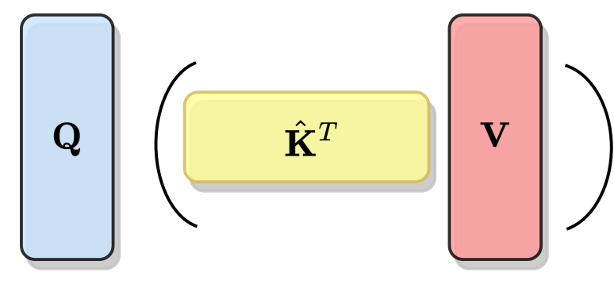
Proposed Algorithm: Insight
$$Softmax\left(\frac{Q{\hat{K}}^{T}}{\sqrt{d}}\right)={\left.{Taylor}_{softmax}\left(\frac{Q{\hat{K}}^{T}}{\sqrt{d}}\right)\right|}_{m=1}$$
$$+{\left.{Taylor}_{softmax}\left(\frac{Q{\hat{K}}^{T}}{\sqrt{d}}\right)\right|}_{m>1}$$
First-Order Approximation
Higher-Order Terms
(Weak Attention)
(Strong Attention)
Training:
Notes:
To address these issues caused by computing higher-order terms, our insight is

Slide 23
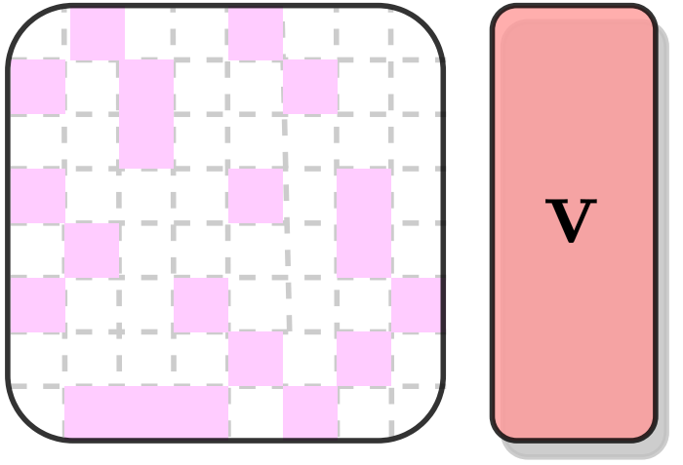
Proposed Algorithm: Insight
$$Softmax\left(\frac{Q{\hat{K}}^{T}}{\sqrt{d}}\right)={\left.{Taylor}_{softmax}\left(\frac{Q{\hat{K}}^{T}}{\sqrt{d}}\right)\right|}_{m=1}$$
$$+{\left.{Taylor}_{softmax}\left(\frac{Q{\hat{K}}^{T}}{\sqrt{d}}\right)\right|}_{m>1}$$
First-Order Approximation
Higher-Order Terms
(Weak Attention)
(Strong Attention)
Training:
Insight: Sparse Attention to approximate higher-order terms
Notes:
We propose to unify low-rank linear Taylor attention with
sparse attention approximation of the higher-order terms,
Here we apply the threshold-based pruning algorithm in Sanger.

Slide 24
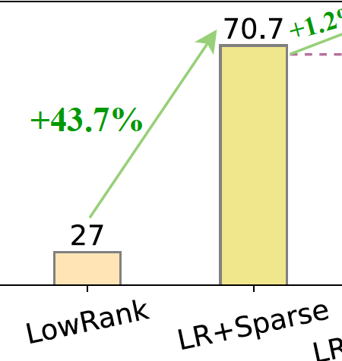
Proposed Algorithm: Insight
$$Softmax\left(\frac{Q{\hat{K}}^{T}}{\sqrt{d}}\right)={\left.{Taylor}_{softmax}\left(\frac{Q{\hat{K}}^{T}}{\sqrt{d}}\right)\right|}_{m=1}$$
$$+{\left.{Taylor}_{softmax}\left(\frac{Q{\hat{K}}^{T}}{\sqrt{d}}\right)\right|}_{m>1}$$
First-Order Approximation
Higher-Order Terms
(Weak Attention)
(Strong Attention)
Training:
Insight: Sparse Attention to approximate higher-order terms
Sparse Attention Benefit
Helps boost accuracy of low-rank linear attention
Notes:
The sparse attention during training helps regularize and boost the accuracy of otherwise low-rank linear attention

Slide 25
Proposed Algorithm: Motivating Observation
$$Softmax\left(\frac{Q{\hat{K}}^{T}}{\sqrt{d}}\right)={\left.{Taylor}_{softmax}\left(\frac{Q{\hat{K}}^{T}}{\sqrt{d}}\right)\right|}_{m=1}$$
$$+{\left.{Taylor}_{softmax}\left(\frac{Q{\hat{K}}^{T}}{\sqrt{d}}\right)\right|}_{m>1}$$
First-Order Approximation
Higher-Order Terms
(Weak Attention)
(Strong Attention)
Training:
Do we need the sparse term for ViT inference ?
Notes:
And we find that sparse attention is not necessary after the training is done:
Because the sparse attention is only useful during the initial training epochs, and it actually diminishes after the first 10 epochs.

Slide 26
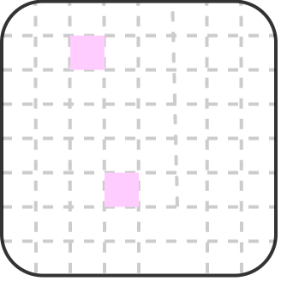
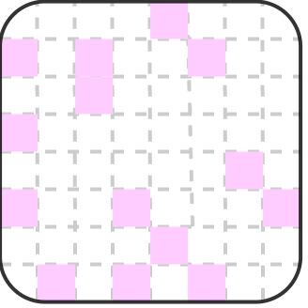
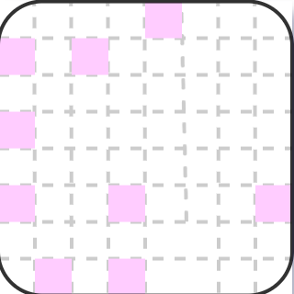
Proposed Algorithm: Motivating Observation
$$Softmax\left(\frac{Q{\hat{K}}^{T}}{\sqrt{d}}\right)={\left.{Taylor}_{softmax}\left(\frac{Q{\hat{K}}^{T}}{\sqrt{d}}\right)\right|}_{m=1}$$
$$+{\left.{Taylor}_{softmax}\left(\frac{Q{\hat{K}}^{T}}{\sqrt{d}}\right)\right|}_{m>1}$$
First-Order Approximation
Higher-Order Terms
(Weak Attention)
(Strong Attention)
Training:
Do we need the sparse term for ViT inference ?
No! It is useful only during initial training epochs
$$…$$
Epoch 0
Epoch 1
Epoch 2
After ~10 epochs
Notes:
And we find that sparse attention is not necessary after the training is done:
Because the sparse attention is only useful during the initial training epochs, and it actually diminishes after the first 10 epochs.

Slide 27
Proposed Algorithm: Training and Inference
Can we avoid dynamic sparsity patterns during runtime ?
Yes! By completely skipping sparsity computation at inference
Training:
Skip Sparse
Inference:
0
Our algorithm executes ONLY linear Taylor Attention during inference
NO dynamic sparsity patterns
Simpler accelerator design without any reconfigurability
Notes:
Based on this observation, we can directly drop the sparse attention
during inference without hurting much of accuracy .
So during inference, we only has a linear attention and we have no dynamic sparsity patterns,
this enables a simpler accelerator design without any need for reconfigurability.

Slide 28
Proposed ViTALiTy Algorithm: Overview
$$Softmax\left(\frac{Q{\hat{K}}^{T}}{\sqrt{d}}\right)={\left.{Taylor}_{softmax}\left(\frac{Q{\hat{K}}^{T}}{\sqrt{d}}\right)\right|}_{m=1}$$
$$+{\left.{Taylor}_{softmax}\left(\frac{Q{\hat{K}}^{T}}{\sqrt{d}}\right)\right|}_{m>1}$$
First-Order Approximation
Higher-Order Terms
(Weak Attention)
(Strong Attention)
Training:
(Vanilla Softmax)
Training:
(Unify Low-Rank Linear Attention with Sparse Approximation)
Skip Sparse
Inference:
(Linear Attention)
0
Notes:
Here is and overview of our proposed algorithm:
During training, we use the sparse attention to approximate the higher order terms, and during inference, we only the linear attention.

Slide 29
Overview of Our Proposed Framework
ViTALiTy: Unifying Low-rank and Sparse Approximation for ViT Acceleration using Linear Taylor Attention
ViTALiTy Algorithm
ViTALiTy Accelerator
Linear Attention
Based on Taylor expansion
and
Algorithm & Accelerator
Co-Design
A training pipeline
Unifies Low-rank
& Sparse Approximation
Merely Low-rank
component for inference
The 1st co-designed ViT work leveraging low-rank linear attention
Higher accuracy (+2.4% to +3.6%) than existing linear attention
3$×$ efficiency than SOTA accelerator

Slide 30
Proposed
ViTALiTy Accelerator
Notes:
OK, then let me introduce the Vitality accelerator.

Slide 31
ViTALiTy Accelerator: Motivation
Challenge: on general computing platforms, FLOPs reduction may not result in a real speed up
3$×$ $\sim$ 10$×$ FLOPs reduction
But only 0.6$×$ $\sim$ 0.8$×$ throughput (on GPUs)
Notes:
Although our proposed algorithm can linearize the computation complexity and achieves 3x-10x FLOPs reduction on the multi-head self-attention layer. Empirically we find that this FLOPs reduction may not result in a real hardware speedup.
On our testing GPUs, we find that the proposed Linear Attention algorithm only achieves 0.6x - 0.8x throughput in the attention layer.

Slide 32
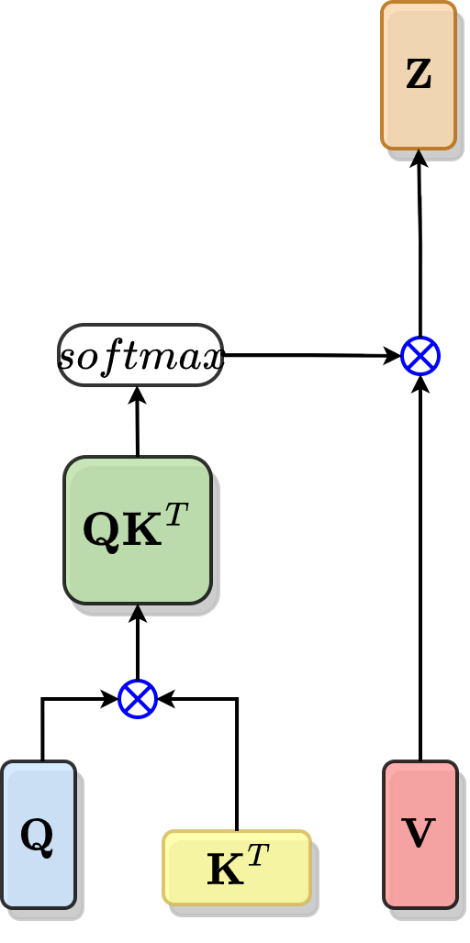
ViTALiTy Accelerator: Motivation
Challenge: on general computing platforms, FLOPs reduction may not result in a real speed up
ViTALiTy
Notes:
This is because, by approximating this Softmax Attention with the proposed Linear Taylor Attention,

Slide 33
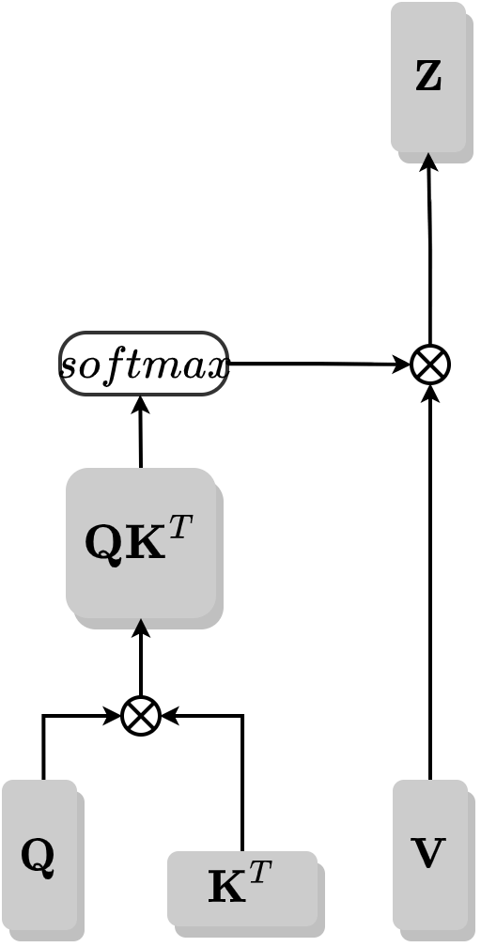
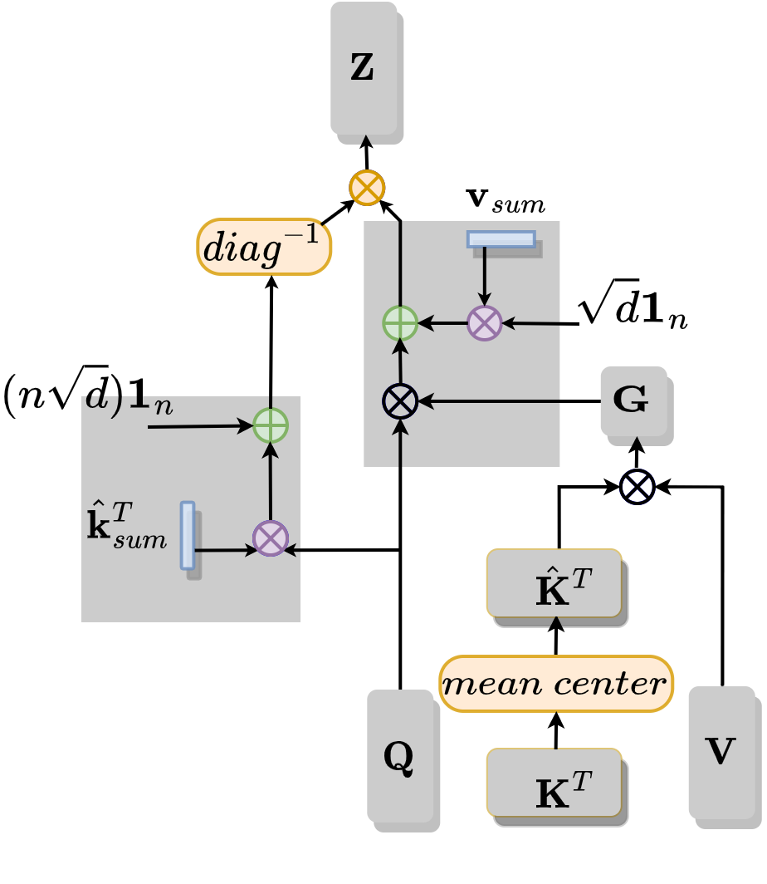
ViTALiTy Accelerator: Motivation
Challenge: on general computing platforms, FLOPs reduction may not result in a real speed up
ViTALiTy
Reason:
ViTALiTy introduced several pre/post-processing operations
Notes:
We introduced several pre/post-processing operations, as highlighted in colors, such as mean-centering, computing row-sum and column-sum of matrices as well as vector-matrix additions, multiplication, and divisions.

Slide 34
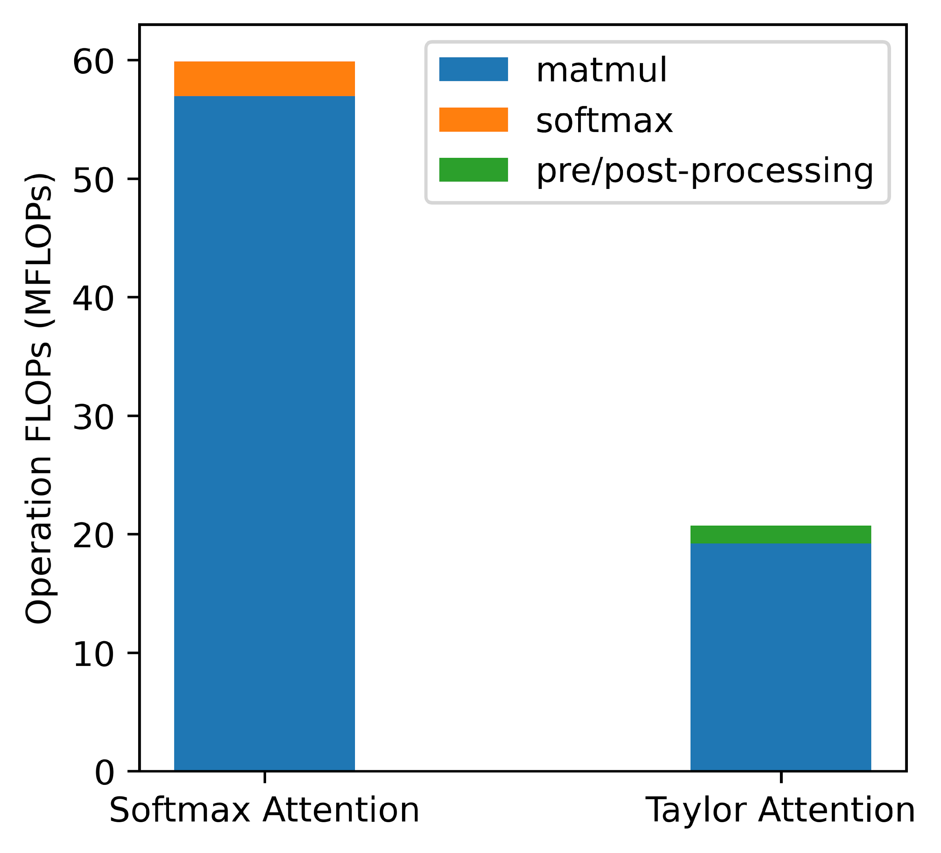
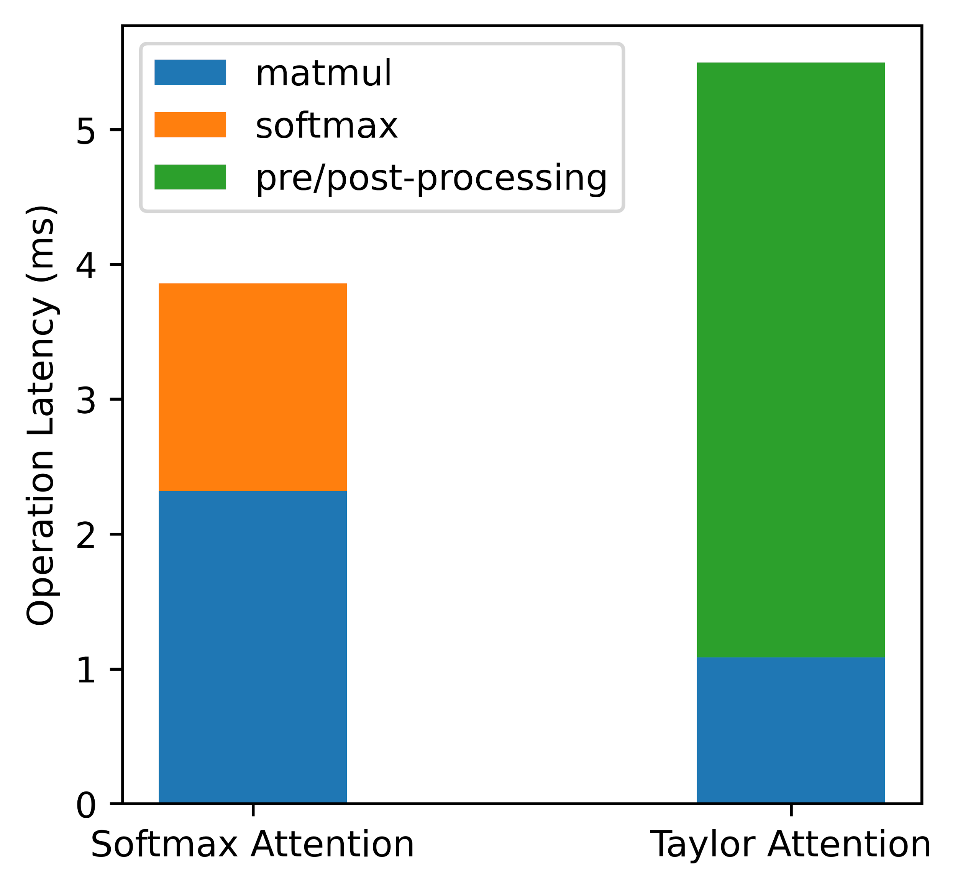
ViTALiTy Accelerator: Motivation
Reason: ViTALiTy introduced pre/post-processing operations
80%
7%
93%
20%
FLOPs breakdown
Latency breakdown
Despite small FLOPs, these pre/post-processing have non-trivial latency overhead
Notes:
By analyzing the FLOPs and latency breakdown of the Softmax Attention and the proposed liner Taylor Attention, we find that:
Despite a small number of FLOPs, the above pre/post-processing operations can have non-trivial latency overhead, they can contribute to about 80% of the overall latency on our testing GPUs.

Slide 35
ViTALiTy Accelerator: Motivation
Despite small FLOPs, these pre/post-processing have non-trivial latency overhead
Why? -> General computing platforms (e.g., GPUs):
w/o dedicated hardware modules
w/o an effective pipeline
Notes:
This is because, on general computing platforms, we do not have dedicated hardware modules to efficiently compute those pre-post processing operations;
and we do not have an effective pipeline to avoid latency bottlenecks due to new data dependencies introduced by these operations.

Slide 36
ViTALiTy Accelerator: Motivation
Despite small FLOPs, these pre/post-processing have non-trivial latency overhead
Why? -> General computing platforms (e.g., GPUs):
w/o dedicated hardware modules
w/o an effective pipeline
Solution: propose a dedicated accelerator
1. Equips with dedicated hardware modules
2. Integrates an optimized pipeline
Notes:
This observation motivates us to build a dedicated accelerator that equips with dedicated hardware modules and Integrates an optimized pipeline to fully leverage our algorithm’s potential.

Slide 37
ViTALiTy Accelerator: Micro-Architecture
Our micro-architecture design features
Multi-chunk design: dedicated sub-accelerators for pre/post-processing
Well-optimized pipeline
Optimized dataflow
Notes:
Based on this motivation, our designed accelerator first features a muti-chunk design: aside from a systolic array for computing matrix multiplications, our accelerator is equipped with multiple sub-accelerators.

Slide 38
ViTALiTy Accelerator: Micro-Architecture
Our micro-architecture design features
Multi-chunk design: dedicated sub-accelerators for pre/post-processing
Well-optimized pipeline
Optimized dataflow
Notes:
each designed for one type of pre/post-processing operations.

Slide 39
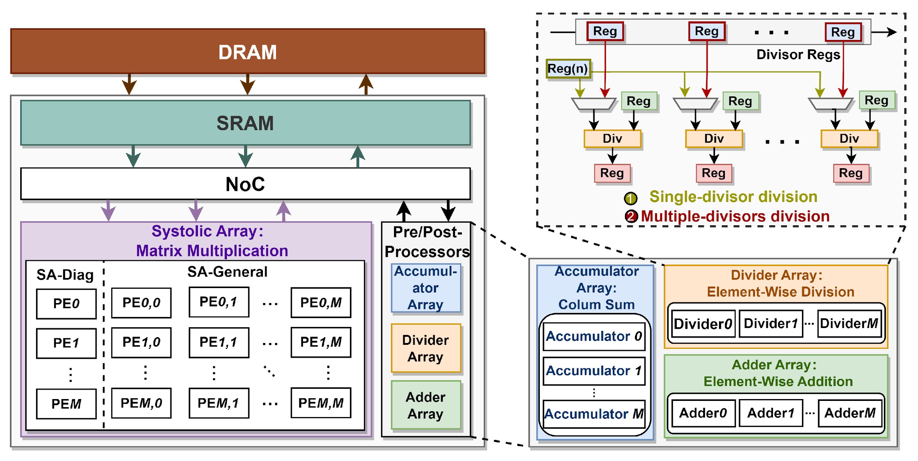
ViTALiTy Accelerator: Micro-Architecture
Our micro-architecture design features
Multi-chunk design: dedicated sub-accelerators for pre/post-processing
Well-optimized pipeline
Optimized dataflow
Notes:
More specifically, we have three sub-accelerators in this red box:

Slide 40
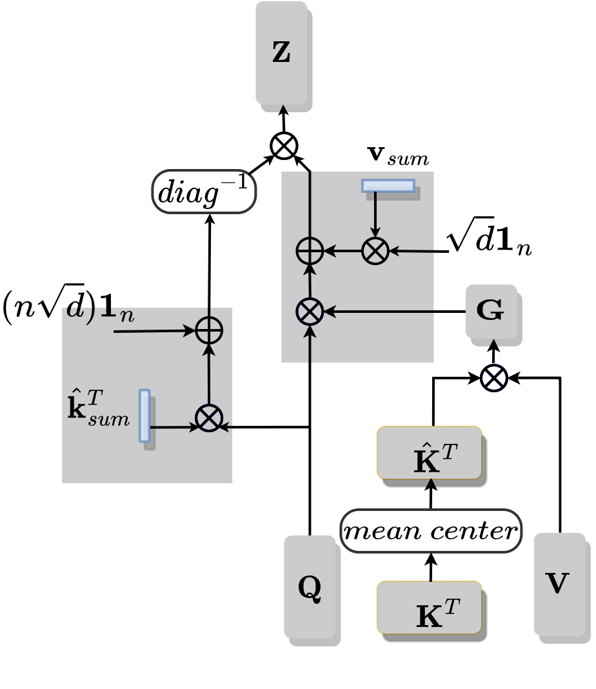
ViTALiTy Accelerator: Micro-Architecture
Our micro-architecture design features
Multi-chunk design: dedicated sub-accelerators for pre/post-processing
Well-optimized pipeline
Optimized dataflow
Notes:
More specifically, we have three sub-accelerators in this red box:
1. The first one is an accumulator array for calculating the row-sum and column-sum of matrices.

Slide 41
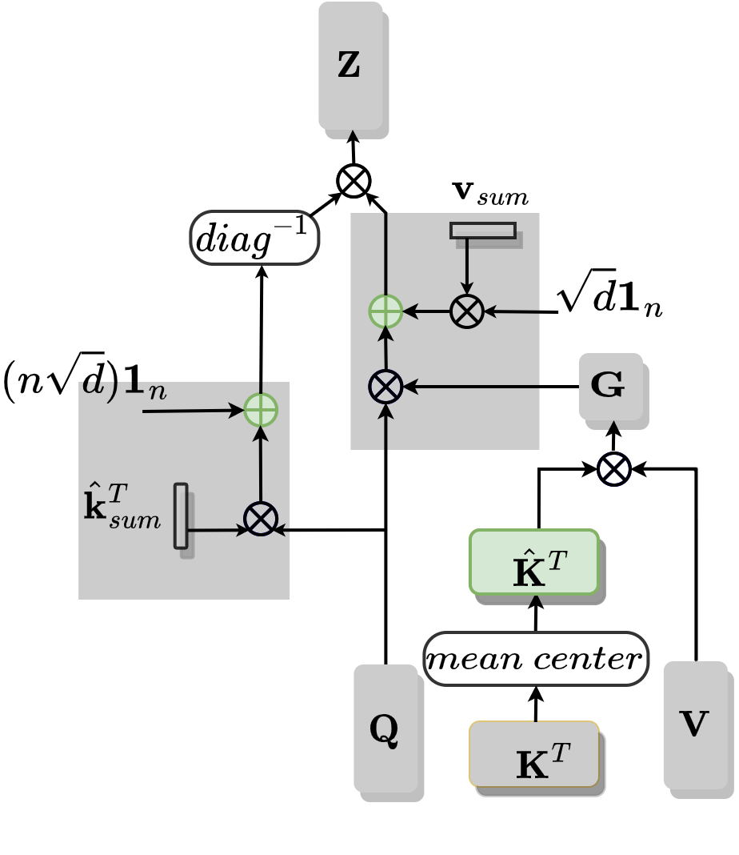
ViTALiTy Accelerator: Micro-Architecture
Our micro-architecture design features
Multi-chunk design: dedicated sub-accelerators for pre/post-processing
Well-optimized pipeline
Optimized dataflow
Notes:
More specifically, we have three sub-accelerators:
1. The first one is an accumulator array for calculating the row-sum and column-sum of matrices. 2. The second one is an adder array, which can be used to compute matrix addition, and mean-centering, which is a normalization technique we used in the proposed algorithm.

Slide 42
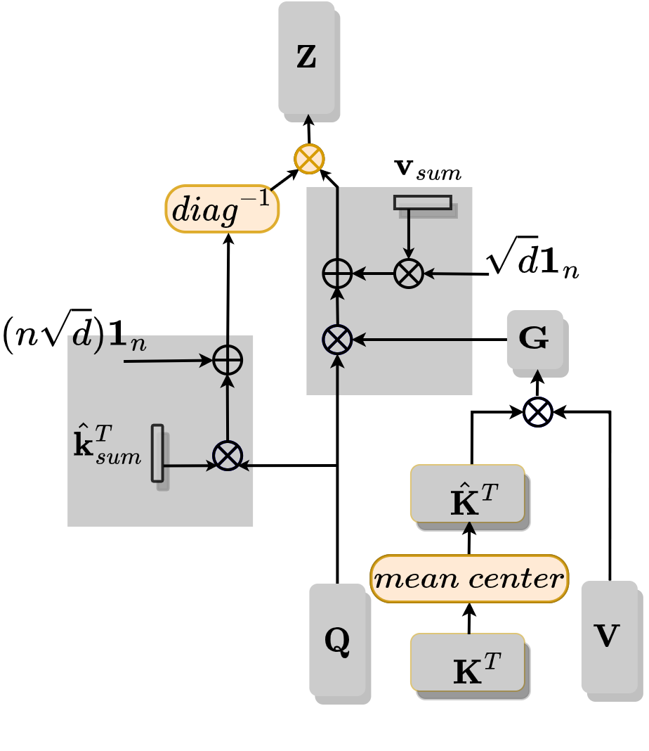
ViTALiTy Accelerator: Micro-Architecture
Our micro-architecture design features
Multi-chunk design: dedicated sub-accelerators for pre/post-processing
Well-optimized pipeline
Optimized dataflow
Notes:
More specifically, we have three sub-accelerators:
1. The first one is an accumulator array for calculating the row-sum and column-sum of matrices. 2. The second one is an adder array, which can be used to compute matrix addition, and mean-centering, which is a matrix normalization technique we used in the proposed algorithm.
3. The third one is a divider array for computing element-wise divisions, and it can support both single-divisor division and multiple-divisor division, for computing mean-centering and matrix-vector division, respectively.

Slide 43
ViTALiTy Accelerator: Micro-Architecture
Our micro-architecture design features
Multi-chunk design
Well-optimized pipeline: efficiently orchestra the sub-accelerators
Optimized dataflow
Naïve Sequential Computing
Notes:
To efficiently orchestra the sub-accelerators under the inter-operation data dependencies, our accelerator is equipped with a well-optimized pipeline:
This graph demonstrates the utilization of each sub-accelerator across time, when computing the proposed linear Taylor attention.

Slide 44
ViTALiTy Accelerator: Micro-Architecture
Our micro-architecture design features
Multi-chunk design
Well-optimized pipeline: efficiently orchestra the sub-accelerators
Optimized dataflow
Naïve Sequential Computing leads to large bubbles
Notes:
To efficiently orchestra the sub-accelerators under the intra-operation data dependencies, our accelerator is equipped with a well-optimized pipeline:
This graph demonstrates the utilization of each sub-accelerator across time, when computing the proposed linear Taylor attention.
We find that naïve sequential computing will result in large hardware bubbles, as shown in the red box here, and therefore leads to a low utilization rate.
Empirically we find many pre-post processing operations can be parallelized and pipelined,

Slide 45
ViTALiTy Accelerator: Micro-Architecture
Our micro-architecture design features
Multi-chunk design
Well-optimized pipeline: efficiently orchestra the sub-accelerators
Optimized dataflow
Leverage the opportunities for parallelization
Notes:
For example, computing row sum of V matrix can be parallelized with computing matrix multiplication between K hat and V.

Slide 46
ViTALiTy Accelerator: Micro-Architecture
Our micro-architecture design features
Multi-chunk design
Well-optimized pipeline: efficiently orchestra the sub-accelerators
Optimized dataflow
Leverage the opportunities for parallelization and pipelining
Notes:
And computing K hat can be pipelined with computing matrix multiplication between K hat and V.
Our pipeline leverages this opportunity of parallelization and pipelining to squeeze the hardware bubbles and leads to a greatly reduced latency.

Slide 47
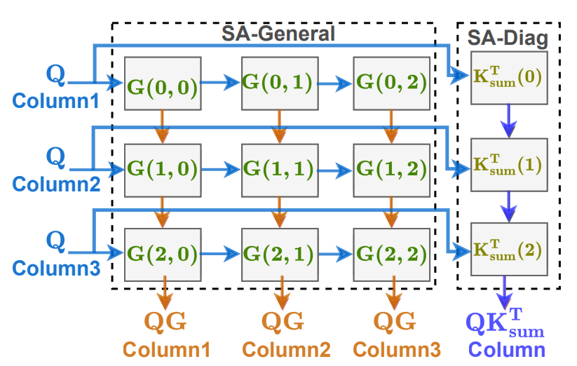
ViTALiTy Accelerator: Micro-Architecture
Our micro-architecture design features
Multi-chunk design
Well-optimized pipeline
Optimized dataflow: input reuse (share input)
Reuse input Q across QG and QK
Notes:
Last but not least, our accelerator adopts an optimized dataflow that takes advantage of input data reuse.
For example, our systolic array can share the input matrix Q when computing matrix multiplication between QG and QK simultaneously.

Slide 48
ViTALiTy
Evaluation and Results
Notes:
Then, let me share the evaluation result.

Slide 49
Evaluation Baselines
Evaluation Setup
Seven ViT Models:
DeiT-Base/Small/Tiny, LeViT-128s/128, and MobileViT-xxs/xs
Dataset:
ImageNet
Metrics:
Accuracy, Latency speedups, and Energy efficiency
Benchmark Baselines
Commercial devices
CPU (Intel(R) Xeon(R) Gold 6230)
GPU (NVIDIA RTX 2080Ti)
EdgeGPU (NVIDIA Tegra X2)
Customized accelerator
Sanger[1] (Sparse Attention)
[1] L. Lu et al., Sanger: A co-design framework for enabling sparse attention using reconfigurable architecture, MICRO ’21
Notes:
We evaluate Vitality across seven vision transformer models,
And we compare it against SOTA hardware baselines, including commercial CPU/GPUs and a customized accelerator – the sanger accelerator which adopts sparse attention.

Slide 50
Hardware Configuration Settings
Settings:
Synthesized with Synopsys Tools under 28nm
Built cycle-accurate model
Adopted a comparable hardware budget for Sanger[1] Accelerator
[1] L. Lu et al., Sanger: A co-design framework for enabling sparse attention using reconfigurable architecture, MICRO ’21
Notes:
For fair comparison, we adopted a comparable hardware budget for our accelerator and the baseline Sanger Accelerator.

Slide 51
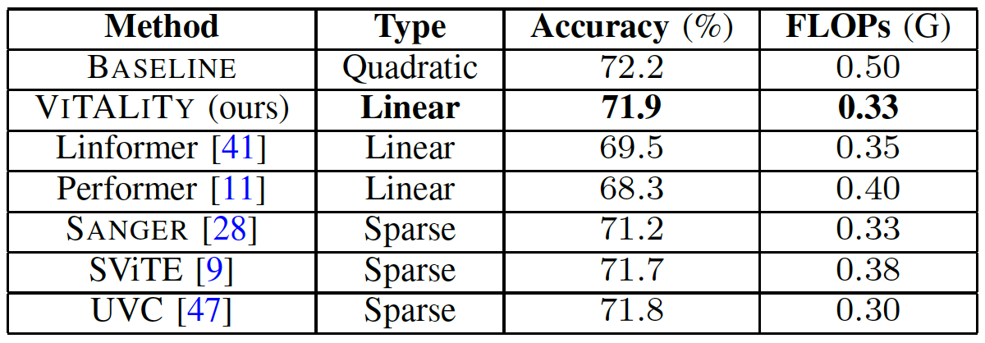
Evaluation of ViTALiTy on Model Accuracy
[arXiv, 2020]
[ICLR, 2021]
[MICRO, 2021]
[NeurIPS, 2021]
[ICLR, 2022]
DeiT-Tiny model
Higher accuracy
+2.4% to +3.6% than linear attentions
+0.1% to +0.7% than sparse attentions
Notes:
The accuracy of our proposed algorithm outperforms linear and sparse attentions

Slide 52
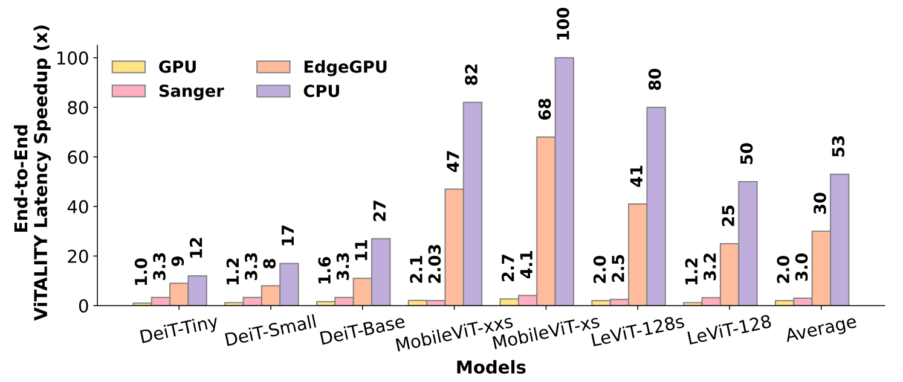
Evaluation of ViTALiTy on Latency Speedup
Evaluation of real speed up
Notes:
This figure shows the relative speedup of the vitality accelerator compared to the four hardware baselines.

Slide 53
Evaluation of ViTALiTy on Latency Speedup
Evaluation of real speed up
53$×$, 30$×$, and 2$×$ end-to-end speedups over CPU, EdgeGPU, and GPU
3$×$ speedup compared to Sanger
Notes:
This figure shows the relative speedup of the vitality accelerator compared to the four hardware baselines.
On average, the vitality accelerator achieves 53x, 30x, and 2x end-to-end speedups over CPU, EdgeGPU, and GPU baselines and 3x speedup compared to Sanger

Slide 54
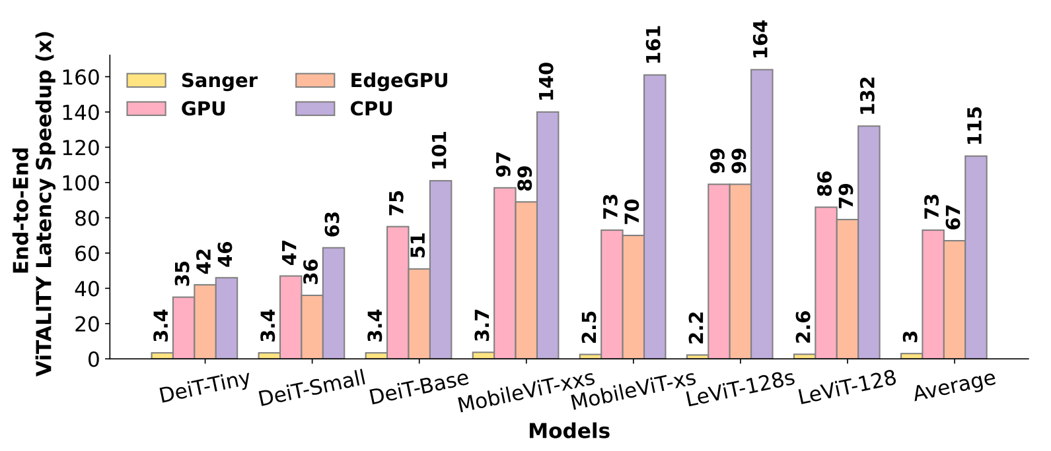
Evaluation of ViTALiTy on Energy Efficiency
End-to-end
ViTALiTy Energy Efficiency Improvement (x)
Evaluation of energy efficiency
Notes:
In terms of energy efficiency, this figure shows the efficiency improvement of our accelerator compared the four hardware baselines.

Slide 55
Evaluation of ViTALiTy on Energy Efficiency
End-to-end
ViTALiTy Energy Efficiency Improvement (x)
Evaluation of energy efficiency
115$×$, 67$×$, and 73$×$ end-to-end better energy efficiency over CPU, EdgeGPU, and GPU
3$×$ better energy efficiency compared to Sanger Accelerator
Notes:
In terms of energy efficiency, this figure shows the efficiency improvement of our accelerator compared the four hardware baselines.
On average, our accelerator achieves 115x, 67x and 73x end-to-end better energy efficiency over CPU, EdgeGPU, and GPU and 3x better energy efficiency compared to Sanger

Slide 56
Summary
Proposed the first algorithm & accelerator co-design framework dubbed ViTALiTy for ViTs with linear attention
Algorithm level: proposed linear Taylor attention of linear complexity without largely compromising the accuracy
Hardware level: developed a dedicated accelerator to better exploit the efficiency benefits of our linear Taylor attention
Acknowledge: Meta Faculty Research Award & NSF CAREER Award
Notes:
To summarize, in this work, … we .. (just read the slides)

Slide 57
Overview of Our Proposed Framework
ViTALiTy: Unifying Low-rank and Sparse Approximation for ViT Acceleration using Linear Taylor Attention
ViTALiTy Algorithm
ViTALiTy Accelerator
Linear Attention
Based on Taylor expansion
and
Algorithm & Accelerator
Co-Design
A training pipeline
Unifies Low-rank
& Sparse Approximation
Merely Low-rank
component for inference
The 1st co-designed ViT work leveraging low-rank linear attention
Higher accuracy (+2.4% to +3.6%) than existing linear attention
3$×$ efficiency than SOTA accelerator

Slide 58
Merci !

Slide 59
APPENDIX

Slide 60
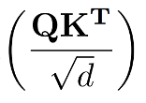
Distribution of Q,K Similarity
Subtracting K by its row-wise average (Attention doesn’t change):
Mean-Centering
ViT Model: DeiT-Tiny
Observations
Up to 67% similarity lies in [-1, 1) corresponding to dense and weak connections
33% similarity lies outside [-1, 1) corresponding to sparse and strong connections
Motivates Taylor expansion of softmax attention to decouple it into
sum of Weak and Strong attentions
Notes:
Within self-attention, matrix multiplications between Q and K, Attn and V occupy up to 53% latency.
Therefore, how to accelerate these core MatMuls in self-attention is the key for ViT acceleration.

Slide 61
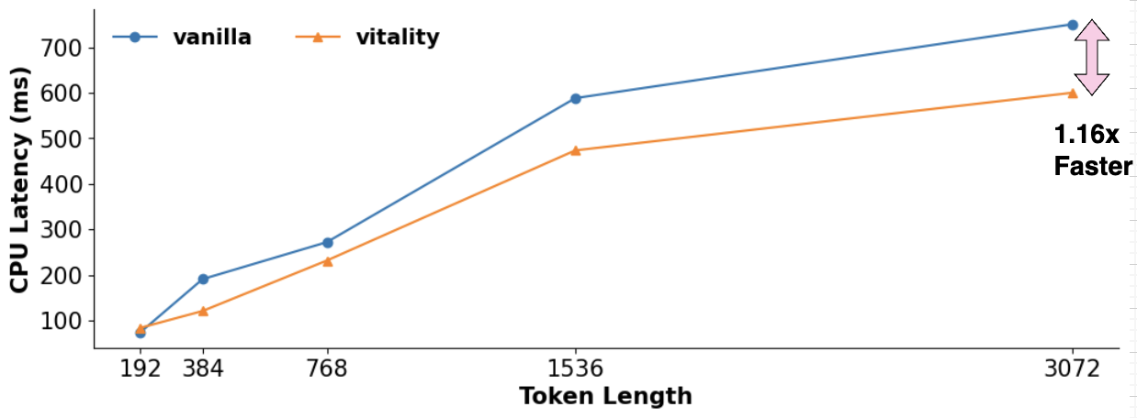
Vanilla Attention vs ViTALiTY Attention
Latency Speedup with increasing Token Length (n)
Intel(R) Xeon(R) Gold 6230
DeiT-Tiny model

Slide 62
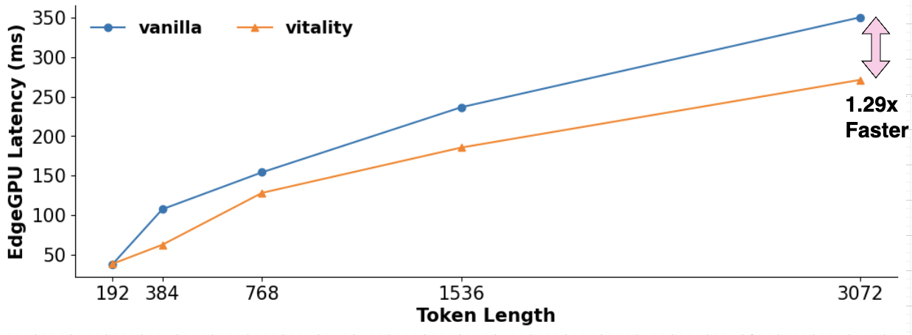
Vanilla Attention vs ViTALiTY Attention
Latency Speedup with increasing Token Length (n)
NVIDIA Jetson TX2
DeiT-Tiny model

Slide 63
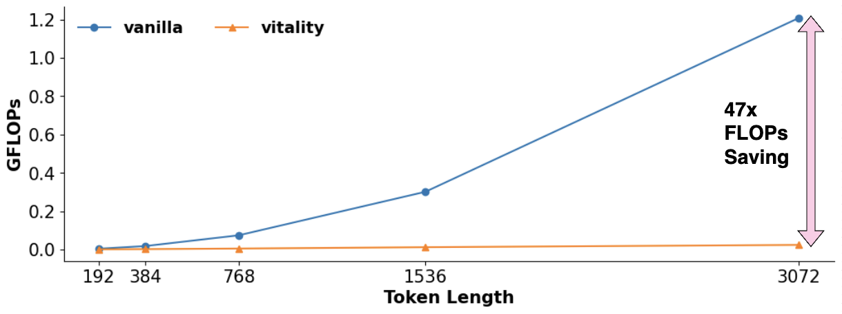
Vanilla Attention vs ViTALiTY Attention
FLOPs Savings with increasing Token Length (n)
DeiT-Tiny model
Notes:
FLOPS single Attention layer

Slide 64
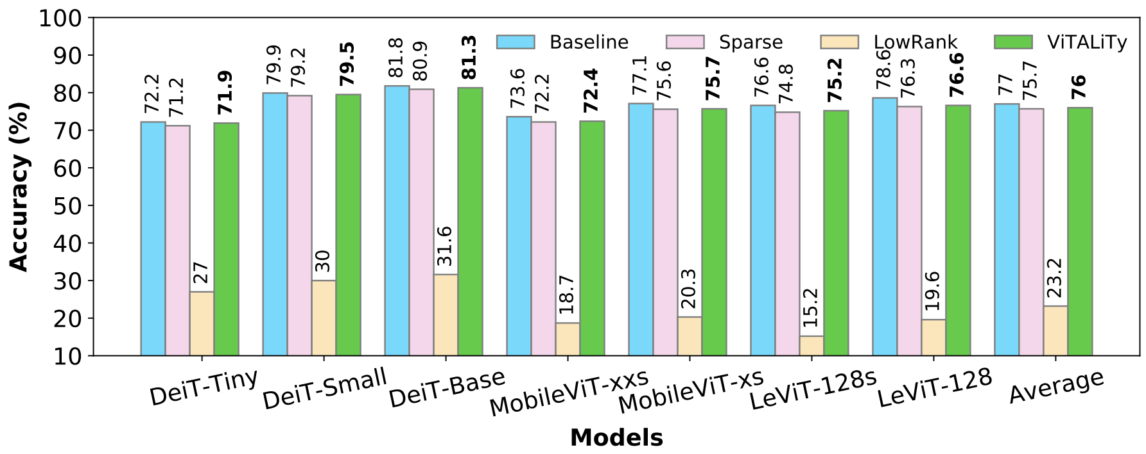
Evaluation of ViTALiTy Algorithm
Evaluation of ViTALiTy’s model accuracy
Sparse: Sanger[MICRO, 21]
Low-Rank: first-order Taylor Approximation w/o our training pipeline
Notes:
This figure shows that in Deit-Tiny: the accuracy of our proposed algorithm stays close to the softmax attention. And outperforms sparse attention and low-rank baseline.

Slide 65
Evaluation of ViTALiTy Algorithm
Evaluation of ViTALiTy’s model accuracy (on avg across 7 ViT models)
+0.3% higher accuracy than SOTA Sparse attention
+52.8% boosted accuracy than Low-Rank attention (w/o training)
Sparse: Sanger[MICRO, 21]
Low-Rank: first-order Taylor Approximation w/o our training pipeline
Notes:
This figure shows that in Deit-Tiny the accuracy of the proposed algorithm stays close to the softmax attention. And outperforms sparse attention and low-rank baseline.
This observation is consistent in all seven vision transformer models.
On avg: our algorithm: (read slides bullets)
(Compact model -> sensitive to compression)

Slide 66
Linear Attention Transformers
ATTENTION TYPES AND CORRESPONDING PRE/POST-PROCESSORS

Slide 67
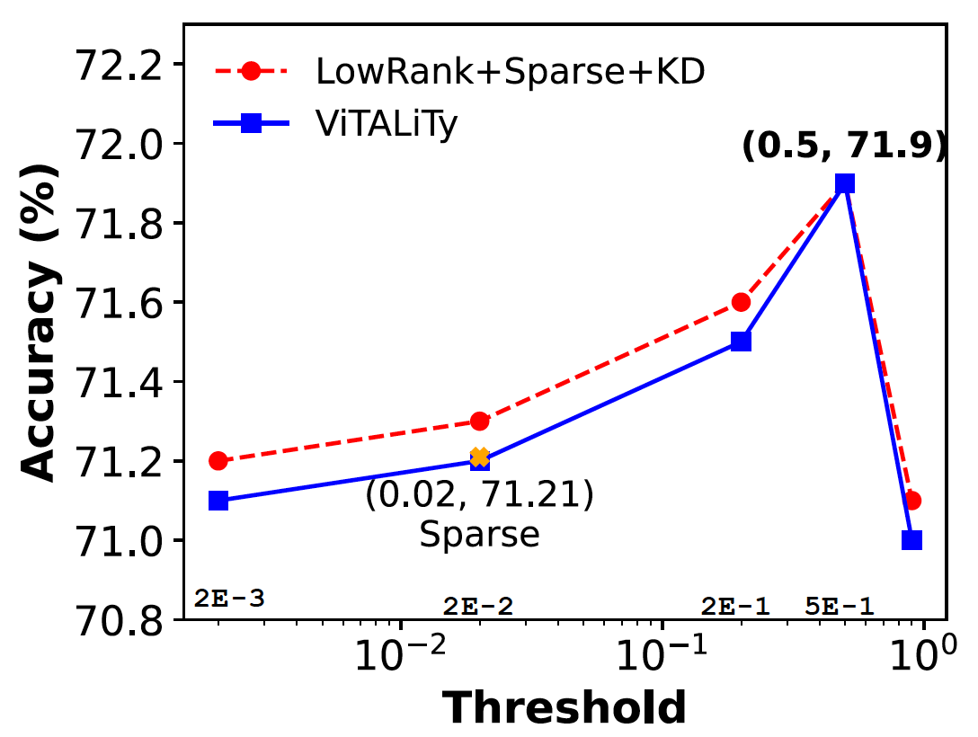
Effect of Sparsity Threshold (Training)
Optimal T
DeiT-Tiny model

Slide 68
Energy Comparison
G-STATIONARY AND PROPOSED DOWN-FORWARD ACCUMULATION

Slide 69
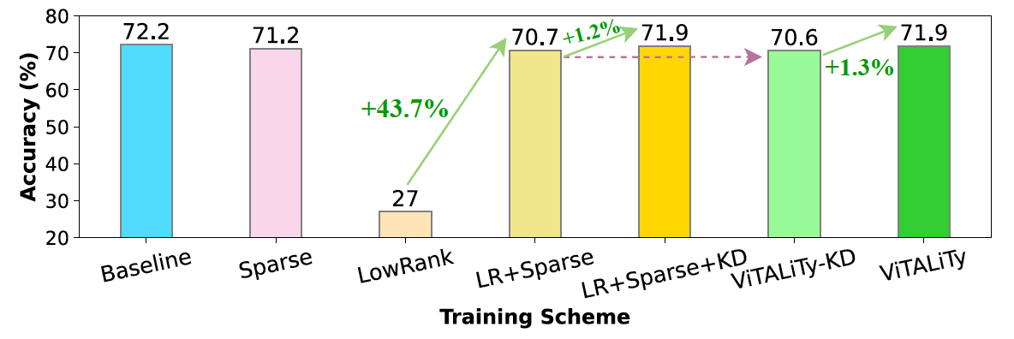
Ablation Study of ViTALiTy
DeiT-Tiny model

Slide 70
Our Findings
Q1: Is softmax the only way to compute attention for ViTs ?
No! It is just one type of similarity measure
What is softmax attention actually capturing ?
Combination of both weak and strong correlations
How can we avoid quadratic complexity in attention ?
Linear attention $↔$ Proposed low-rank linear Taylor attention
Q2: Is sparsity necessary for ViT inference ?
No! It is useful only during initial training epochs
Can we avoid dynamic sparse patterns during runtime ?
Yes! By completely skipping sparsity computation at inference
How to design efficient ViT-based accelerators for edge ?
Executing only low-rank component
Notes:
JD: Here we summarize our findings thus far
-------- NO NEED now-----
Here we present our findings that are key to our proposed ViTALITy algorithm
First, the softmax is simply a special case of similarity measure between Q matrix and K matrix. By using matrix associative property, where K matrix and V matrix are multiplied first, leads to an attention with linear space and time complexity.
(click)
Second, we identify that softmax attention inherently captures both weak and strong connections between Q matrix and K matrix which allows it to be decoupled as Taylor expansion.
(click)
Based on the findings, we propose Linear Taylor attention as a low-rank approximation for softmax attention.

Slide 71
Accuracy v FLOPS (Attention) Tradeoff
DeiT-Tiny model

